Slide 1
Keeping Food Safe
Green Family
Sonia H, Nicole S, Karly B, Josh C
Block 2

Slide 2
Chapter 25: Keeping Food Safe

Slide 3
Objective
Vocabulary
Name and describe the microorganisms that cause food to spoil
Differentiate between food intoxication and food infection
Identify sources and symptoms of foodborne illnesses
Explain the role of various government agencies that keep the food supply safe
Demonstrate steps to prevent the spread of foodborne illnesses
Assess the safety of food preparation methods
Adulterated
Botulism
Cross-contamination
Food Infection
Food Intoxication
Foodborne Illness
Parasites
Pathogenic
Pesticides
Residue
Spores
Notes:
Sonia

Slide 4
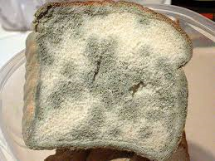
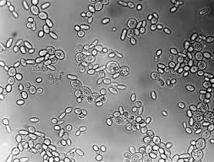
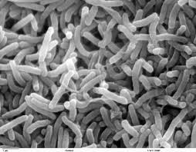
Foodborne Illness
Food Borne Illness: An illness caused by eating food that has been contaminated in some way
There are 3 Microorganisms of Food Illness
Molds: aerobic organisms that tell you food is going bad, but are usually more wasteful than harmful
Yeast: One-celled plant, and use spores to survive harsh conditions
Spores: Microorganisms in a dormant, inactive, or resting state
Bacteria: Most threatening, even though only 20 bacteria cause foodborne illness, can grow aerobically or anaerobically.
Only die at certain temperatures
Moldy Bread
Yeast Spores
Bacteria
Notes:
Sonia

Slide 5
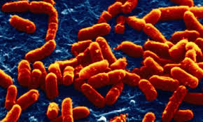
Food Intoxication
Food Intoxication: A bacterial foodborne illness that occurs when microorganisms grow in food and produce a toxin there. The toxin causes the illness when the food is eaten.
Types of Bacteria that Will Cause it
Clostridium Perfringens : Grow naturally in your intestine, but if ingested in large numbers can cause sickness. Might grow on food left out at room temperature.
Staphylococcus Aureus: Commonly known as a staph infection , and is usually brought in from a human source, and improperly stored meats.
Clostridium Botulinum: Grow in contaminated fish, and poorly stored cans… can cause botulism
Botulism: a very serious – and sometimes fatal – form of food poisoning
Staph Infection
Notes:
Karly

Slide 6
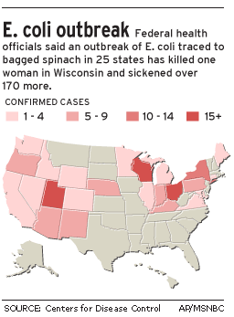
Food Infections
Food Infections: Bacterial borne illness that occurs when pathogenic microorganism enter the body with the food.
Pathogenic: Disease carrying
Types of Bacteria that Will Cause it
Salmonella Enteritidis: Occurs mainly in undercooked eggs, but can occur in most undercooked meats. It can come from cross-contamination, and causes illness.
Cross Contamination: the transfer of bacteria from one food to another
Escherichia Coli: Commonly known as a E. Coli it lives in animals, but will infect a person if the food isn’t cooked properly. It can cause death by attacking cells.
Listeria Monocytogenes: Found in the soil, but if ingested can cause sickness, it lives harmlessly in animals, but is harmful when passed on through to people
Notes:
Karly

Slide 7
Common Food Intoxications and Infections
Common Food Intoxications and Infections
Illness | Cause | Symptoms | Sources | Prevention
Clostridium Poisoning | Toxin produced by Clostridium Perfringens | Stomach Cramps, Chills, Headache, Diarrhea | Meat, Poultry, Hot foods cooled to room tempurature | Keep hot foods hot, refrigerate uneaten foods
Staph Infection | Toxin produced by Staphylococcus Aureus | Severe Vomiting, Stomach Cramps, Diarrhea | Moist, cooked meat dishes or starches at room temperature | Refrigerate uneaten foods
Botulism | Toxin produced by Clostridium Botulinum | Nausea, Vomiting, Diarrhea, Fatigue, Double Vision, Muscle Paralysis, Lung Failure | Low-acid canned foods, honey (for infants) | Heat canned foods thoroughly, do not give infants honey
Salmonellosis | Infection by Salmonella | Nausea, Fever, Diarrhea, Ab Pain, Headache, | Meat, Poultry, Eggs, Milk, Cross contamination | Cook foods thoroughly, follow sanitation rules
E. Coli Poisoning | Infection by Escherichia coli 0156:H7 | Diarrhea, Brain Damage, Kidney Failure, HUS | Undercooked beef, unpasteurized milk | Cook beef thoroughly, follow sanitation rules
Listeriosis | Infection by Listeria Monocytogenes | Fever, Chills, Nausea, Miscarrige | Soft Cheese, ready to eat deli meats | Heat ready to eat meats to steaming, avoid likely foods
Notes:
Josh

Slide 8
Review on Food Intoxication and Food Infection
http://education-portal.com/academy/lesson/what-is-a-foodborne-illness-definition-and-common-types.html#lesson
(8:00min.)
Notes:
Josh

Slide 9
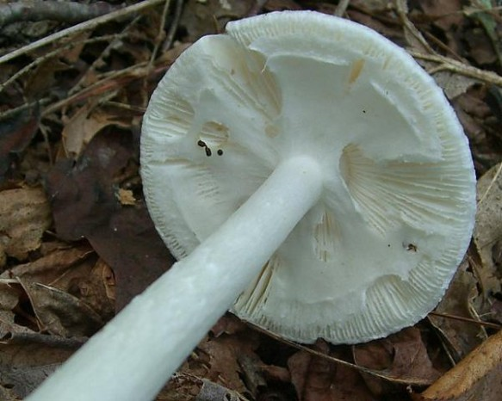
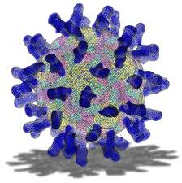
Other Causes
Parasites: organisms that grow and feed on other organisms
Comes form improperly cooked foods
Viruses
An infected person can pass it on form person to person
Pesticides: Chemicals used to kill insects, animal pests, and weeds
Can still be on foods if not stored or processed properly
Natural Toxins
Stuff found in mushrooms that are not safe and can cause death within hours
Destroying Angel Mushroom
Common Cold Virus
Notes:
Josh

Slide 10
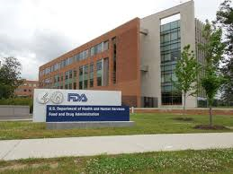
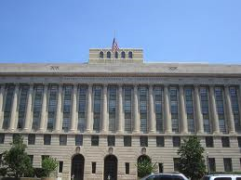
Government and Food Safety
Few Laws that check for Adulterated foods
Adulterated: Made impure by the addition of improper ingredients
Agencies check for residues
Residues: The matter remaining after a chemical or physical process
4 Major Agencies
FDA: Food and Drug Administration
United States Department of Agriculture
President’s Council on Food Safety
International Agencies
United States Department of Agriculture
Notes:
Nicole

Slide 11
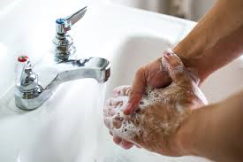
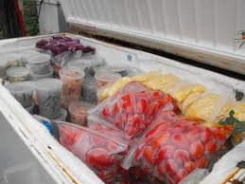
What you can do to prevent!
Practice Cleanliness
Wash your hands
Store Food Safely
If it needs to be frozen freeze it
Handling Food with Care
Do not cross-contaminate foods
Use expert advice
Prepare Foods Properly
Wash fruits and veggies
Cook meat thoroughly
Notes:
Nicole

Slide 12
Preventing Foodborne Illness
http://www.teachertube.com/viewVideo.php?video_id=272127
Notes:
Nicole

